Slide 1
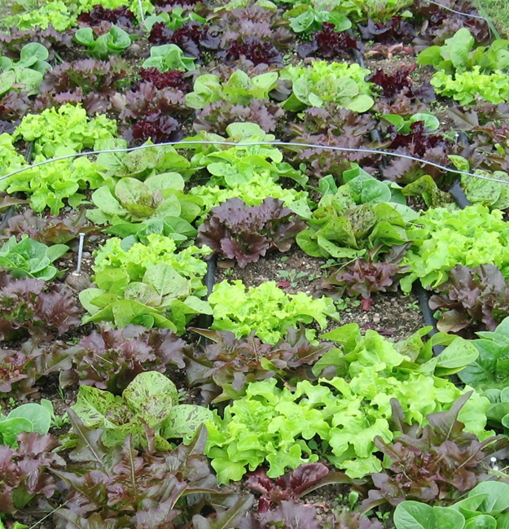
Current Status of Certified Organic Agriculture in Washington State: 2020
2020 Data: extracted 2-9-2021
Final Document date: 12-21-2021
Photo: C. Miles
David Granatstein
formerly with WSU-Center for Sustaining Agriculture and Natural Resources
In cooperation with Washington State Department of Agriculture, Oregon Tilth and CCOF

Slide 2
Introduction
Washington State University has been providing statistical profiles on the Washington State organic sector since 2000. Annual updates on all crops reported have been done since 2004. The information presented in this document provides the 2020 update for the state, along with some national and global data.
The goal of this document is to make detailed timely information on the dynamic organic sector readily available to growers, businesses, policymakers, and others interested in organic agriculture. Detail is generally provided at the level reported to the certifier. The WSDA Organic Program certified 91% of the NOP-certified farms in the state in 2020, and it is the primary data source. Oregon Tilth Certified Organic (OTCO) and California Certified Organic Farmers (CCOF) also regularly provide data. Other certifiers are contacted for their information, but it is not always complete.
Note: Sums may not always agree for the same parameter due to data inconsistencies and errors.
2

Slide 3
Consumer Demand for Organic Food
Growth Rate
15.7%
7.4%
6.6%
Source: World of Organic Agriculture
7

Slide 4
Growth of US Organic Food Sales
Consumer Demand
5.9% of US retail food sales
Retail organic food sales increased 12.8% in 2020. Organic fruits and vegetable sales increased 13.3% and were 36% of all organic food sales (and 15% of all US produce sales); over 90% were sales of fresh produce.
Source: OTA, Nutrition Business Journal

Slide 5
Washington Organic Farm Area
148,002
108,664
128,528
C=124,213 ac T= 4,315 ac
C+T=Certified (includes Pending) + Transition; includes all site area but no double crop 2005-2020. WSDA only 1995-2003; additional data added from other certifiers beginning in 2004.

Slide 6
Distribution of Certified Organic Acres
Washington State
Combined certifier data; double crop acres included

Slide 7
Distribution of Certified Organic Acres
Washington 2020
Certified crop acres*: 122,816
*includes 1,693 ac double crop
Transition crop acres: 4,176
Total certified site area = 124,213 ac (e.g. includes undefined land not tracked as crop)
Combined certifier data
7

Slide 8
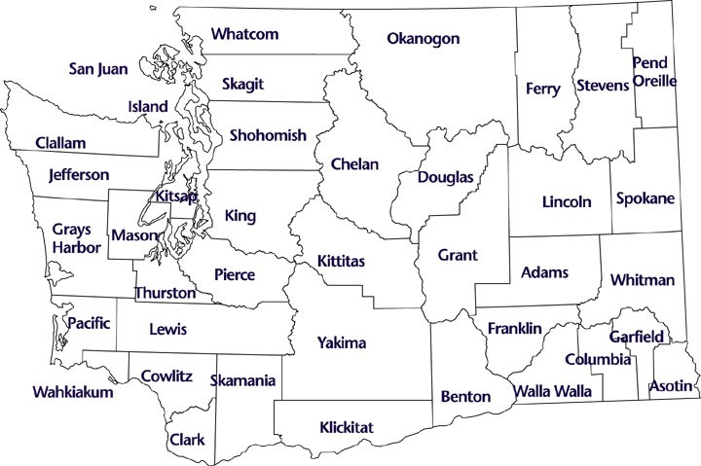
2020 Certified Farm Area by County (acres)
2,357
--
Area*
Cert 124,213 ac
Trans 4,315 ac
Eastern WA 77%
of certified ac
Okanogan
104 0.25
--
1,708
6,805 67
5,805 208
363
1,769 114
724
2,891
50
2,119
35
652
1,942
967
2,854-35
348
28 0
39,419
1,845
5,793-78
32
1,067 0
1,837
951
100
1660
0
Western WA 23%
of certified ac
10,176
8,391
--
--
6,714 0
7,350 346
1216
648
287
43
--
0.06
3,005
75
5,118 22
314-96
Blue=certified
Red=transition
WSDA, OTCO, CCOF data. *Area is the total of farms’ certified or transition site acreage. Farms may have additional transition acreage that is not reported.

Slide 9
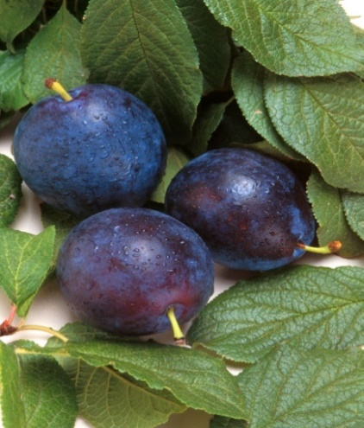
Organic Tree Fruit Acres
Washington State
 | --- Certified acres --- |  |  |  |  |  |  |  | Trans acres†
 | 2010 | 2012 | 2014 | 2016 | 2017 | 2018 | 2019 | 2020 | 2020
Apple | 14,790 | 13,657 | 14,052 | 16,191 | 22,116 | 28,473 | 32,537 | 30,424 | 1,122
Pear | 2,033 | 1,900 | 1,843 | 2,243 | 2,763 | 3,263 | 4,201 | 4,256 | 128
Cherry | 2,147 | 1,792 | 1,939 | 2,078 | 2,546 | 3,014 | 3,352 | 3,180 | 75
Apricot* | 299 | 266 | 299 | 251 | 216 | 271 | 360 | 268 | 9
Nectarine | 550 | 488 | 440 | 379 | 357 | 470 | 472 | 318 | 0
Peach | 701 | 618 | 580 | 553 | 580 | 580 | 602 | 469 | 0
Plum/Prune* | 125 | 89 | 58 | 76 | 45 | 49 | 53 | 106 | 1
Mixed stone | 13 | 45 | 17 | -- | 1 | 4 | 2 | 0 | 0
Total* | 20,658 | 18,855 | 19,228 | 21,771 | 28,624 | 36,122 | 41,580 | 39,021 | 1,335
ARS Photo
*apricot includes aprium; plum includes prune, pluot and plumcot; totals do not include mixed tree fruit;
†only those acres registered with a certifier
Organic tree fruit accounted for about 14% of all tree fruit acres in Washington State in 2018.
Combined certifier data

Slide 10
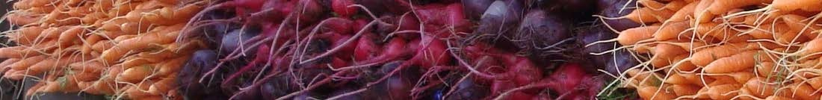
WA Organic Vegetable Acres
Reported 2020 certified vegetables = 18,391 acres
Estimated organic acreage share: Sweet corn 6.8%;
Peas 10.5%; Onion 8.1%
Organic acreage share is the % of all state acres of the crop that are certified organic
Combined certifier data

Slide 11
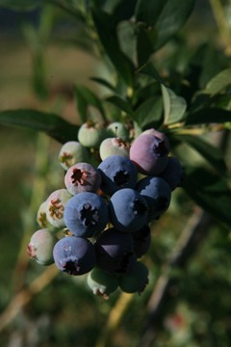
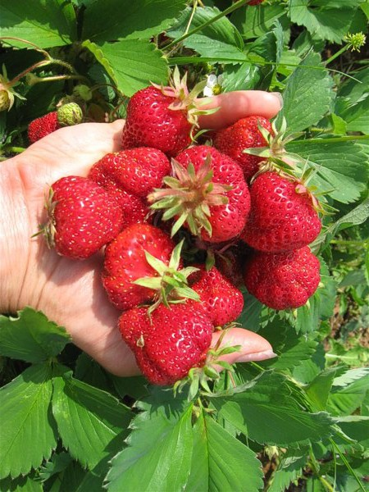
Washington Organic Berry Acres
Photo: Blue Dog Farm
Blueberry 2020:
4,133 ac certified
671 ac trans.
Organic is ~23% of total WA blueberry acreage (using 18,200 harvested ac state total from NASS 2020).
Photo: Boistfort Valley Farm
Combined certifier data
11

Slide 12
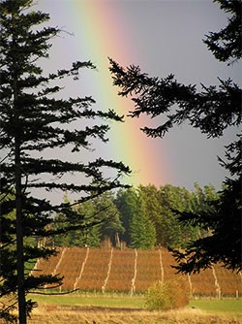
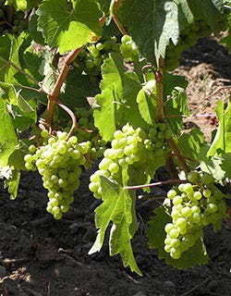
Washington Organic Grape Acres
M. McCoy
Reported 2020 total certified grapes = 2,891 acres
(Concord = 68%)
Estimated organic share of WA grape acreage = 10% of juice and 1% of wine grapes
Lopez Island Vineyards
Combined certifier data

Slide 13
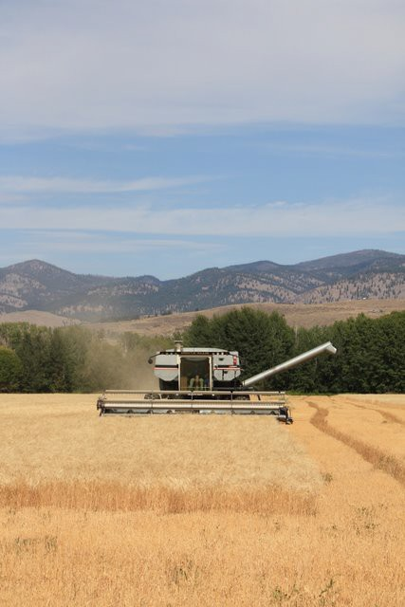
Organic Grain, Pulse & Oilseed Acres
Washington State
© Bluebird Grain Farms Organic Emmer
Reported 2020 organic grain, pulse and oilseed = 20,611 acres
Combined certifier data

Slide 14
Organic Grain, Pulse & Oilseed Acres
Washington State
© Bluebird Grain Farms Organic Emmer
Reported 2020 organic grain, pulse and oilseed = 20,611 acres
Combined certifier data

Slide 15
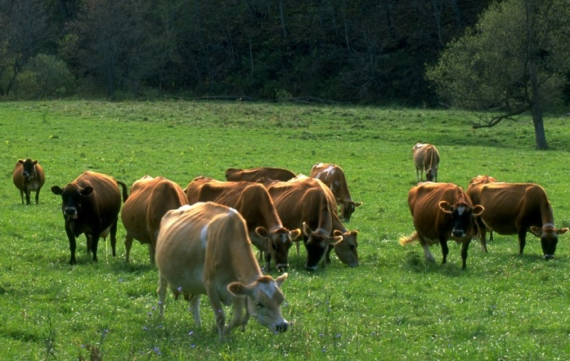
Organic Dairy Cow Numbers Washington State
Photo: Organic Valley
Combined certifier data, primarily WSDA and OTCO

Slide 16
Washington Organic Livestock
- - - % of total state / US organic sales - - -
 | WA |  |  |  | US
 | 2014 | 2015 | 2016 | 2019 | 2014 | 2015 | 2016 | 2019
Livestock sales | -- | 6% | 6% | 9% | 12% | 12% | 15% | 17%
Livestock product sales | -- | 19% | 10% | 10% | 28% | 31% | 29% | 25%
2019 WA | # inventory | # sold | Sales $
Milk cows | 9,657 | 2,403 | 2.25 Mil
Beef cows | 584 | 43 | 69 K
Other cattle, calves | 7,736 | 3,923 | 4.42 Mil
Layers | 1,025,900 | *(nd) | 84 K
Broilers | 2,108,276 | 10,058,508 | 68.6 Mil
Goats, Kids | *(nd) | *(nd) | *(nd)
*nd: not disclosed
33.6 mil dozen in 2015; 4.6 mil doz. in 2008
Sources: USDA NASS 2014, 2015, 2016, 2019 Certified Organic Surveys and 2008 Organic Production Survey

Slide 17
Distribution of WA Organic Farmgate Sales
by Sales Class*
Farm size class by gross annual sales
*WSDA farms only. Gross farmgate sales in dollars. 718 farms reported sales in 2020. Sales do not include values from new applicants or farms that did not reapply during reporting year. Producer-processors not included.

Slide 18
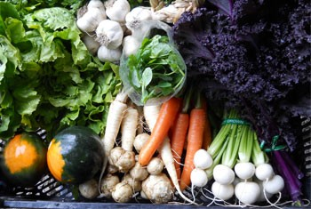
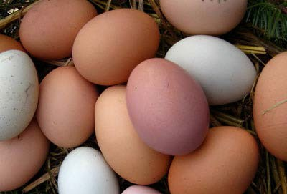
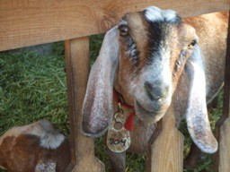
Trend of Farmgate Sales Value
Cert. Organic Crop and Animal Products
Washington State Producers
 | --------2020--------
 | Million $ | % +/- 2019-20 | % of $ | % of acres
East | 601 | -4 | 78 | 77
West | 168 | +13 | 22 | 23
Total | 769 | -1 | 100 | 100
Red Dog Farm
Finn River Farm
Sunny Pine Farm
WSDA and OTCO data only. Farmgate sales do not include values from farms that were new applicants, that did not renew certification during reporting year, or that reported as processor or handler sales.

Slide 19

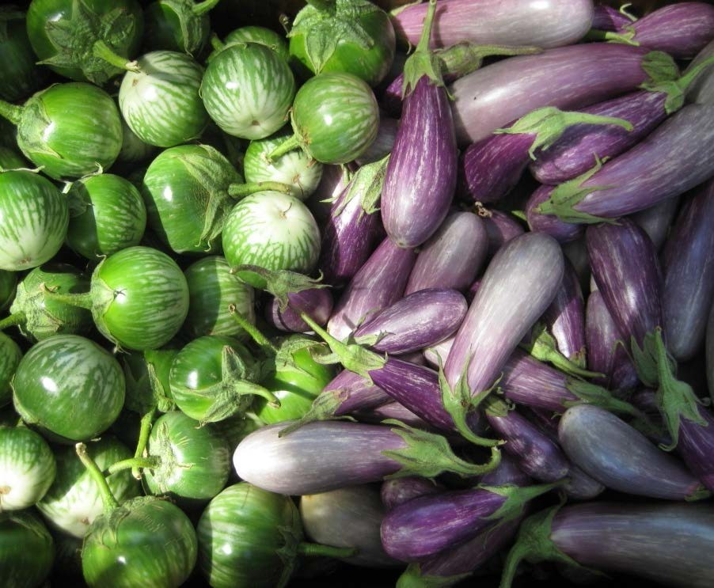
Estimated Certified Organic Share of Washington Agriculture
No. Farms 2.7%
(2020 base data, 35,500 farms)
Cropland 1.7%
(2019 base data)
Value 8.6%
(NASS 2020 data, at least $8.702 billion)
If organic ag was considered a single commodity, it would rank no. 6 among all Washington commodities for dollar value in 2020 (after apples, milk, cattle, wheat, and potatoes).
Alvarez Farm produce: C. Donovan
Comparisons are based on the combined certifier organic data and the statewide data from NASS and WSDA

Slide 20
U.S. Organic Exports
Apples ($90 mil) were the leading U.S. organic produce export in 2020, followed by grapes ($74 mil) and leaf lettuce ($68 mil).
“other” is all other select organic exports tracked by GATS
Source: USDA-FAS GATS

Slide 21
2019 NASS Organic Survey
WA CA
% of US cert. organic farms 4.5 18.2
% of US cert. organic cropland 2.7 12.4
% of US total organic sales 8.9 36.2
  WA ranks #2 after CA
% of US organic crop sales 12.4 49.7
Est. $ sales per acre cropland 7,523 6,557
  WA ranks #1, US ave. is $1,645/ac
WA grows a higher percentage of high-value specialty crops compared to most states.

Slide 22
2019 NASS Organic Survey
WA Organic Fruit Production
 | % US* | US rank | Top State | Value Mil $
Apple | 93.3 | 1 | WA | 447.6
Cherry, sw | 91.8 | 1 | WA | 28.37
Pear | 73.7 | 1 | WA | 18.3
Apricot | 21.6 | 2 | CA | 1.2
Nectarine | 22.1 | 2 | CA | 2.4
Peach | 17.8 | 2 | CA | 3.9
Blueberry | 45.7 | 1 | WA | 74.3
Raspberry | 10.8 | 2 | CA | 0.6
Grapes | 6.4 | 2 | CA | 8.9
* WA share of total US production
WA accounts for 30.9% of US farmgate organic fruit sales worth $590 mil

Slide 23
2019 NASS Organic Survey
WA Organic Vegetable Production
 | % US* | US rank | Top State | Value Mil $
Carrot | 5.1 | 2 | CA | 6.31
Herbs | 7.9 | 2 | CA | --
Onion (all) | 13.6 | 3 | OR | --
Peas, gr | 39.0 | 1 | WA | 8.39
Potato | 19.3 | 2 | CA | 8.91
Spinach | 1.8 | 2 | CA | 4.21
Squash | 10.7 | 2 | CA | 5.38
Sweet corn | 40.8 | 1 | CA | 9.84
Other | -- | 2 | CA | 11.31
* WA share of total US production
WA accounts for 3.8% of US farmgate organic vegetable sales worth $80 mil

Slide 24
2019 NASS Organic Survey
Livestock
# farms Peak animals % of US
Milk cows 45 9,657 2.7
Other cows 60 8,320
Layers 29 1.026 mil 5.1
Broilers 13 2.108 mil 7.2
Production
Milk 45 136.89 mil lb 2.7
Eggs 25 18.201 mil doz 4.6
2019 organic milk value = $39.2 mil
2019 organic egg value = $52.9 mil

Slide 25
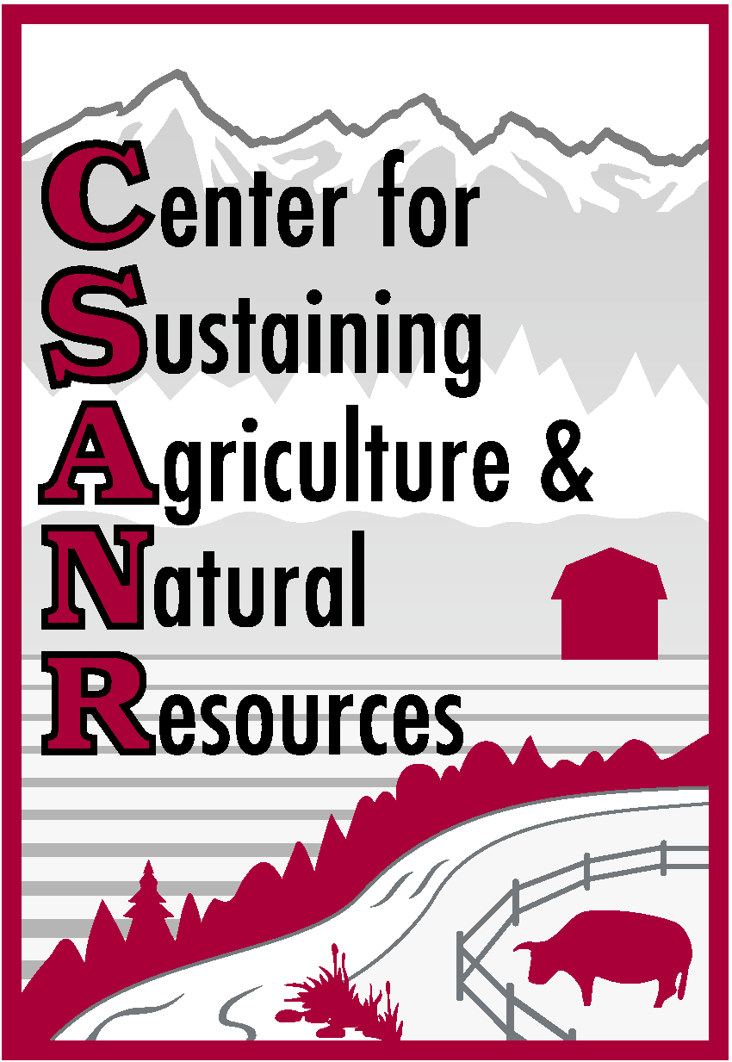
Organic Data Sources
USDA-AMS Market News – a list of organic reports
https://www.ams.usda.gov/market-news/organic
These include: Organic Dairy; Livestock, Poultry and Grain; National Organic Grain and Feedstuffs; Organic Poultry and Eggs; Weekly Feed and Seed Summary; Specialty Crops (a searchable database, includes fruits and vegetables); Cotton; Retail Markets (local and organic).
USDA-NASS organic surveys. https://www.agcensus.usda.gov/Publications/Organic_Survey/
USDA-ERS http://www.ers.usda.gov/topics/natural-resources-environment/organic-agriculture.aspx Organic market overview, organic production area, organic trade, individual research reports.
USDA-FAS has international trade data for many organic products in its Global Agricultural Trade System.
USDA NOP Organic Integrity Database. https://apps.ams.usda.gov/integrity/
Current information on certified farms and companies by state and products. No acreage data at present.
http://tfrec.cahnrs.wsu.edu/organicag/organic-statistics/

Slide 26
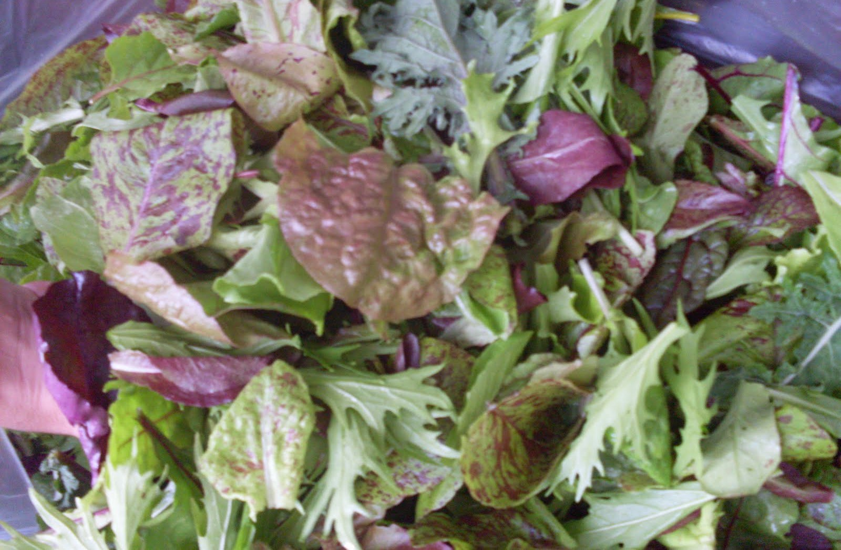

Visit our websites for more information!
http://csanr.wsu.edu/pages/Organic_Statistics or
http://tfrec.cahnrs.wsu.edu/organicag/organic-statistics/
Citation: Granatstein, D. and E. Kirby. 2019. Current status of organic agriculture in Washington State: 2018. Organic Trend Series, Center for Sustaining Agriculture and Natural Resources, Washington State University, Wenatchee, WA.
Photo: Sunbreak Farm website

